Slide 1

Archita Sogani
Shruti Nogja
Chaitanya Patil
Jheel Gala
Ali Shaikh

Slide 2
Problem statement
Develop a real-time options chain tool for processing market data and calculating implied volatility.
Enable dynamic updates without page reloading, ensuring a seamless user experience.
Deliver a high-quality solution with functional correctness, intuitive UI, strong performance, and innovative features.

Slide 3
Our approach
Researched options trading concepts and terminology, including option chains and implied volatility.
Developed a clear step-by-step plan to meet the project requirements.
Assigned tasks based on individual strengths and expertise.
Maintained regular communication for progress tracking and issue resolution.
Carefully evaluated and selected a tech stack aligned with project goals.
Developed core functionalities using efficient algorithms and clean coding principles.
Conducted rigorous testing for reliability and accuracy.

Slide 4
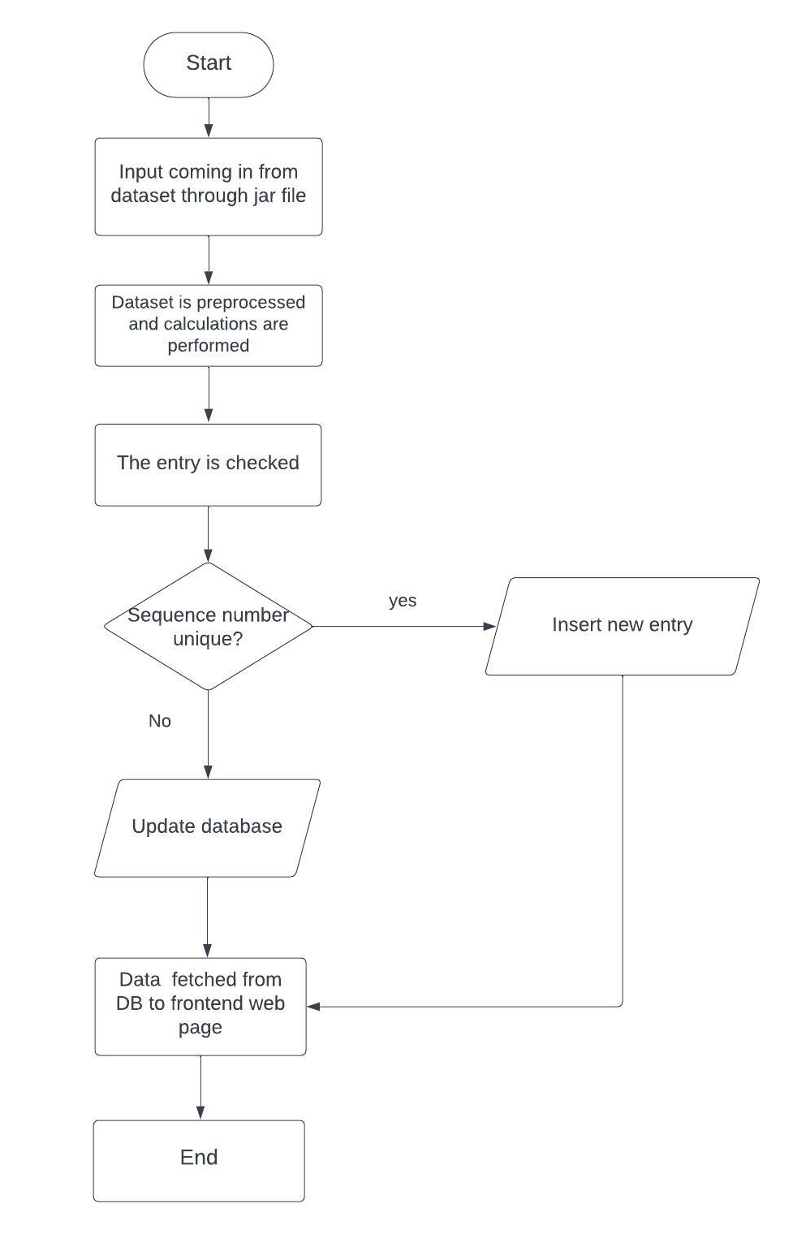
Flowchart

Slide 5
Tech Stack Used
Python
NodeJS
Javascript
HTML
CSS
Bootstrap
VScode

Slide 6
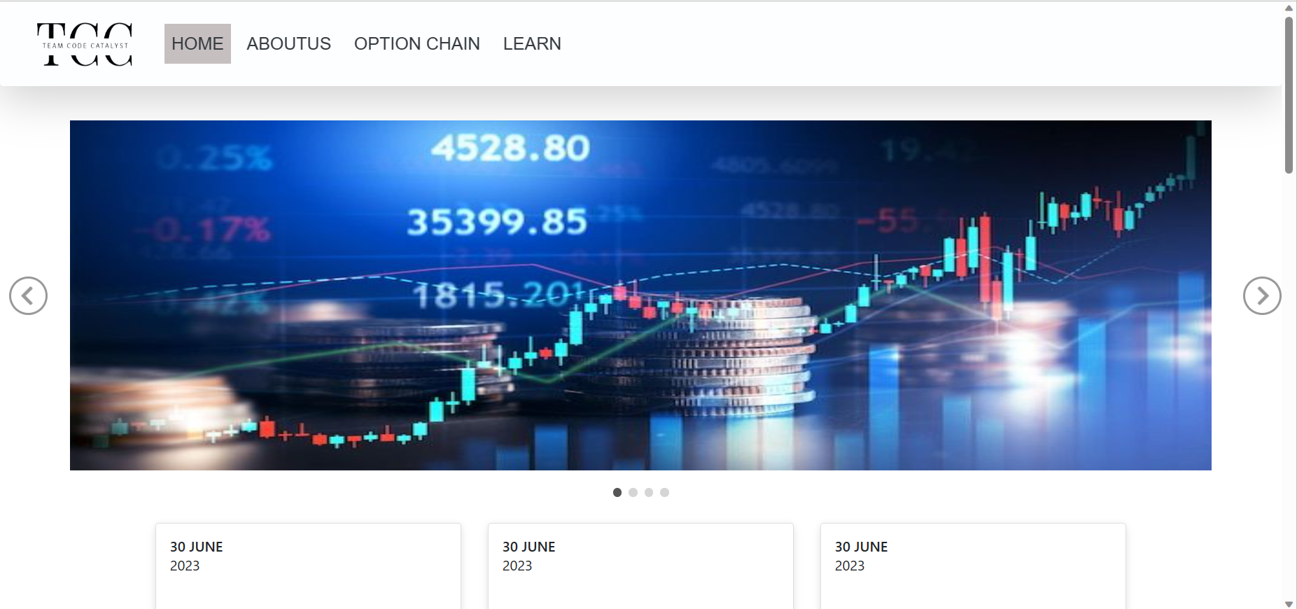
UI Screen Shots

Slide 7
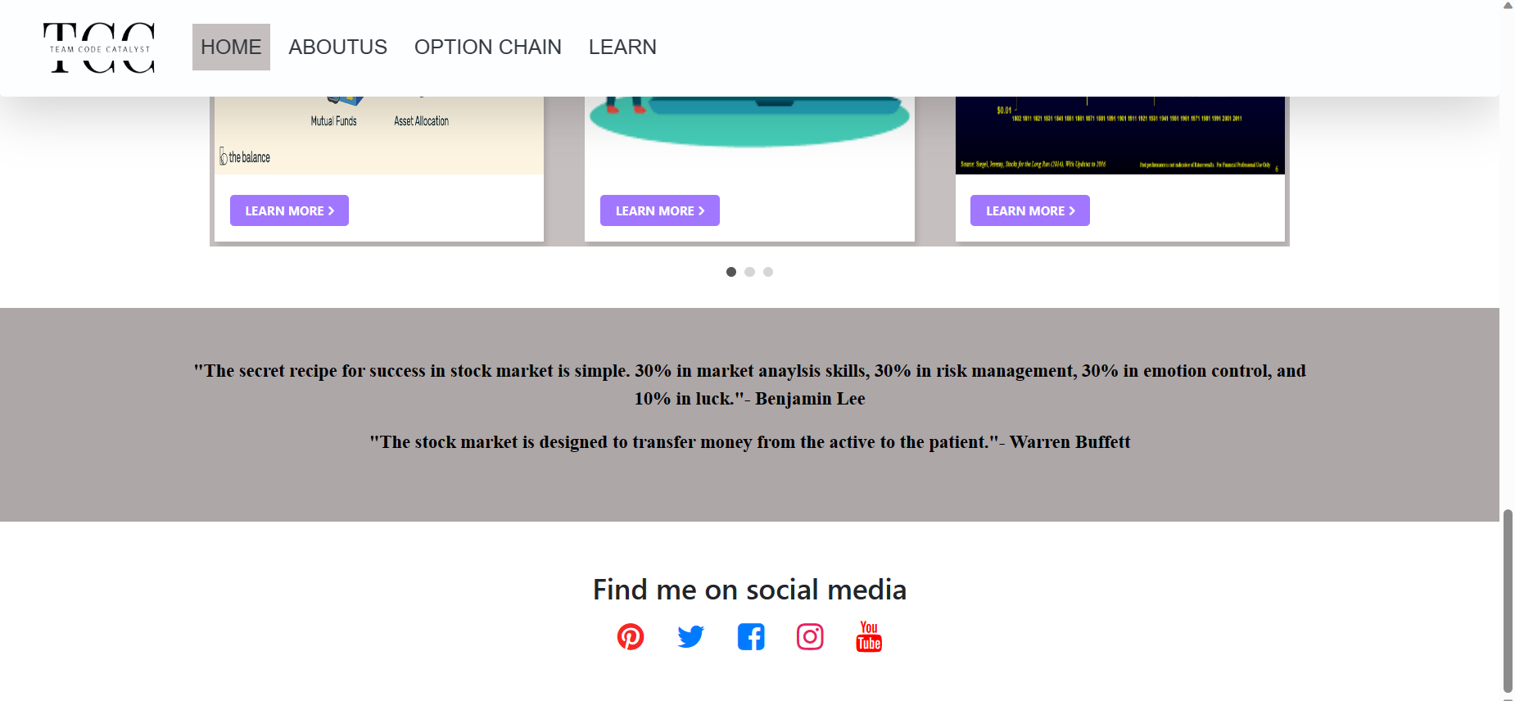

Slide 8
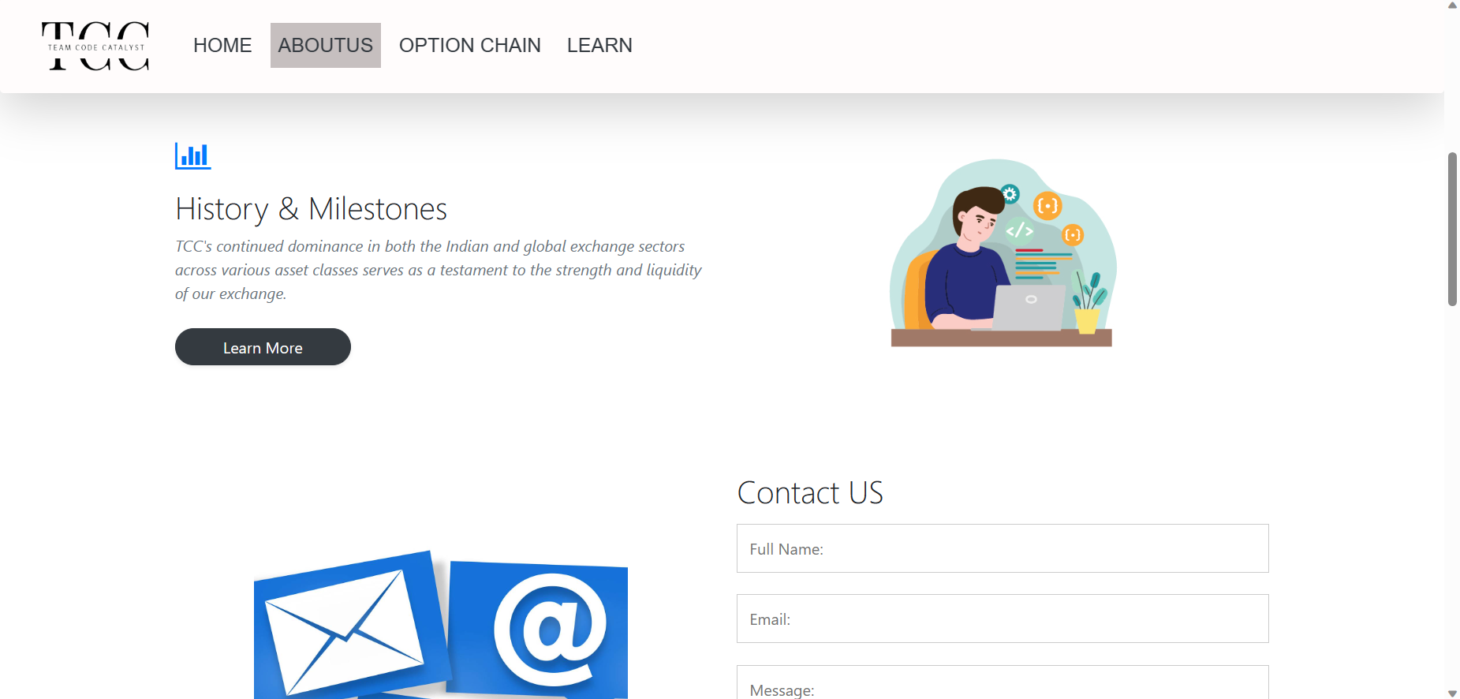

Slide 9
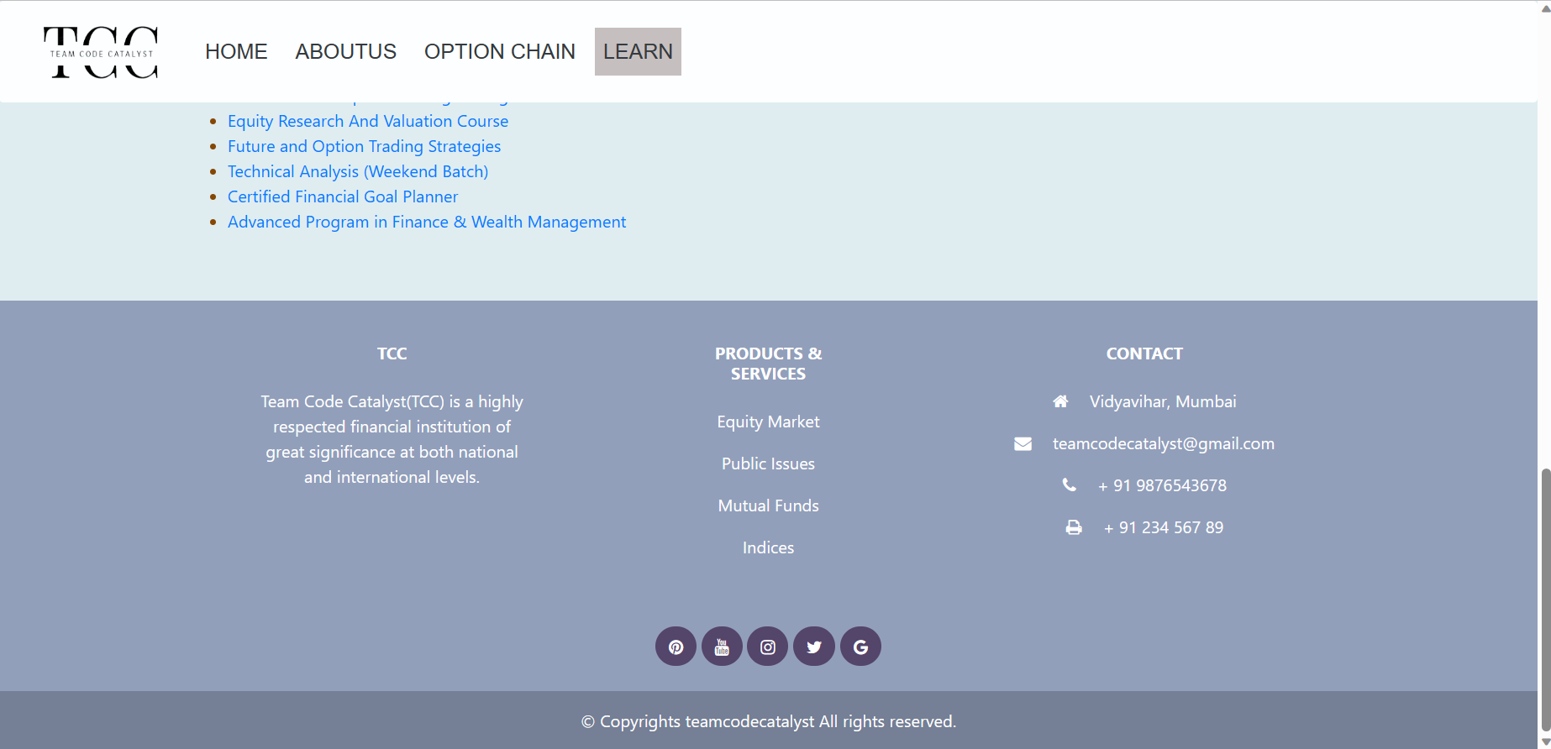

Slide 10
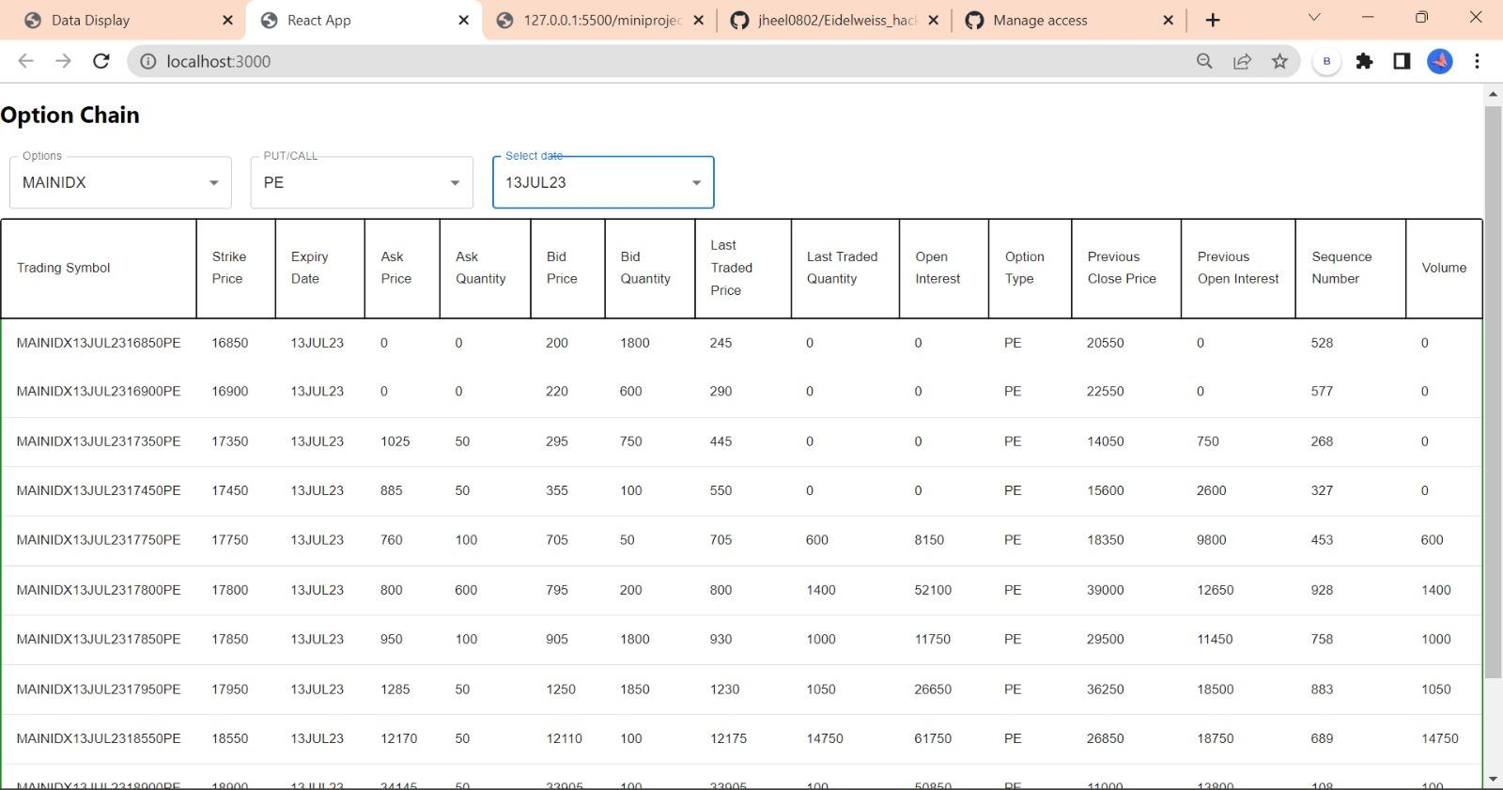

Slide 11
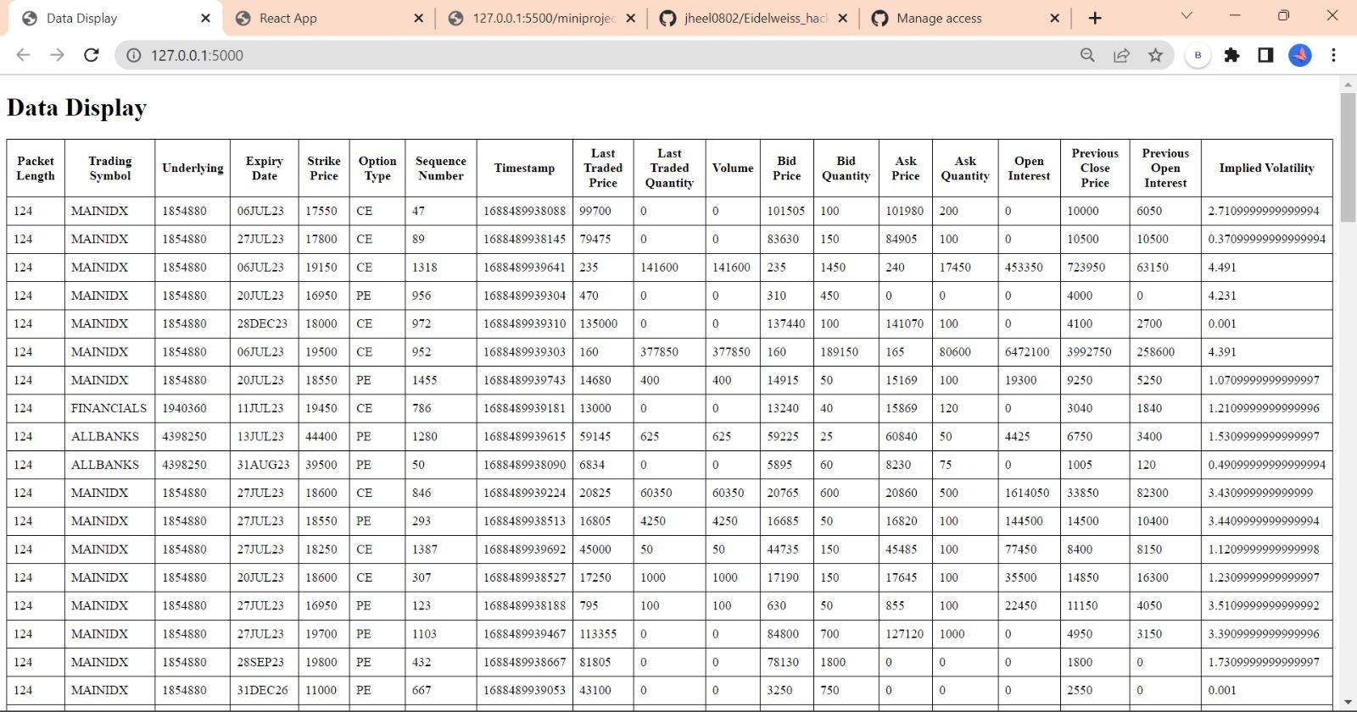

Slide 12
Problems Solved
Developed an options chain tool that addresses the need for real-time market data analysis and visualization.
Provides users with a comprehensive overview of available options, highlighting "in the money" and "out of money" options.
Calculates and displays implied volatility, a crucial metric for options trading decisions.
Offers flexibility with selection of underlying assets and different expiry dates.
Ensures real-time updates without the need for page reloading, facilitating prompt decision-making.

Slide 13
Our unique selling points
In-depth Understanding: We acquired comprehensive knowledge of options trading, including option chains, implied volatility, and call/put options.
Technical Proficiency: Leveraging our technical background, we mastered the required technologies and coding skills to build a robust and efficient solution.
User-Centric Design: Our application prioritizes user experience with an intuitive interface and clear visual representations, making complex financial data accessible to all traders.
Collaborative Teamwork: Our strong teamwork and effective collaboration ensured efficient task allocation and seamless integration of individual contributions.

Slide 14
Future Scope
Advanced Filtering: Provide customers with extra choices for filtering the options chain according to factors like open interest, volume, bid-ask spread, Greeks, and more. Users would have more freedom to customise their options chain view as a result.
Analysis of Historical Market Data: Include historical market data to allow users to examine and contrast option chains for various time periods. This might involve displaying past implied volatility trends, spotting patterns, and doing analysis using historical data.
Custom Watchlists: Users can establish and manage bespoke watchlists of particular options contracts for easy monitoring and reference. This would make it possible for traders to monitor their favoured options and concentrate on particular trading techniques.

Slide 15
Conclusion
In conclusion, the development of a real-time options chain tool for processing market data and calculating implied volatility is a significant endeavor that empowers options traders with valuable insights and analysis. The tool provides a user-friendly interface with dynamic updates, allowing traders to monitor options chains, highlight in-the-money and out-of-money options, and customize their view based on underlying assets and expiries.
Overall, the development of the real-time options chain tool addresses the needs of options traders by offering a powerful platform for analyzing options data, calculating implied volatility, and making informed trading decisions.

